Slide 1
Explainability for Proactive Robot Assistance
Presentation for Montai Health
By Amirtha Varshini

Slide 2
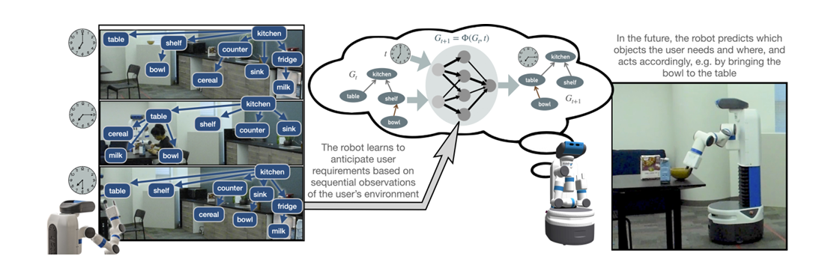
Background
The model to be explained –
A graph neural network model (GNN) that performs spatio-temporal object tracking and models the future movement of objects in an environment.

Slide 3
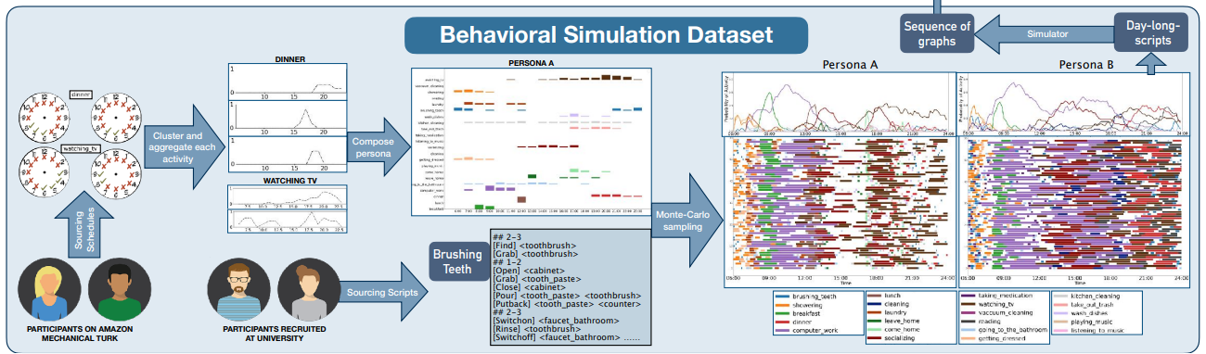
The dataset

Slide 4
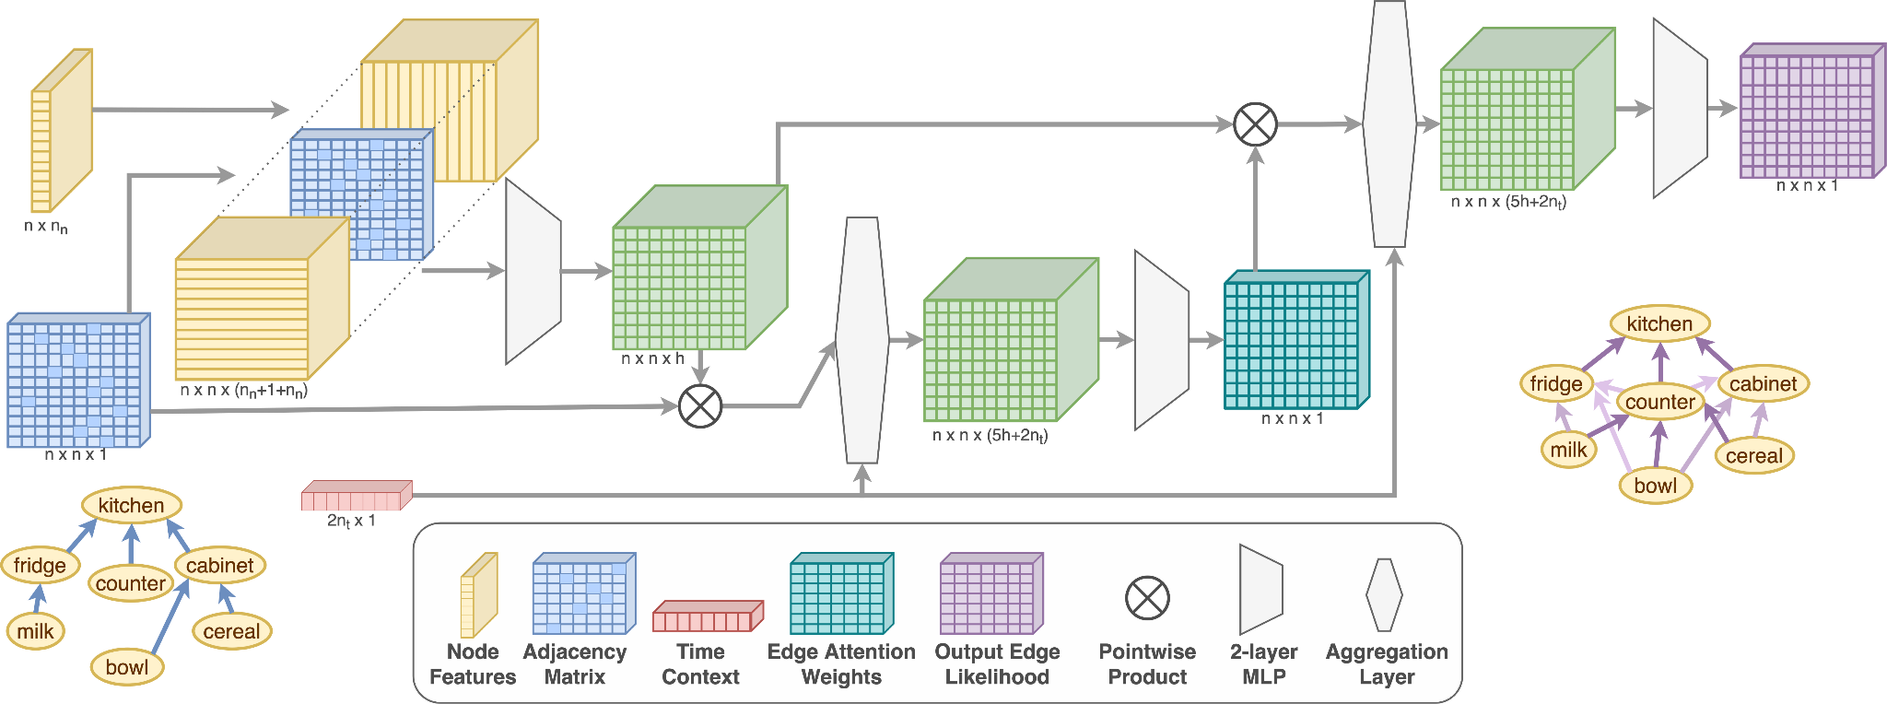
The model architecture

Slide 5

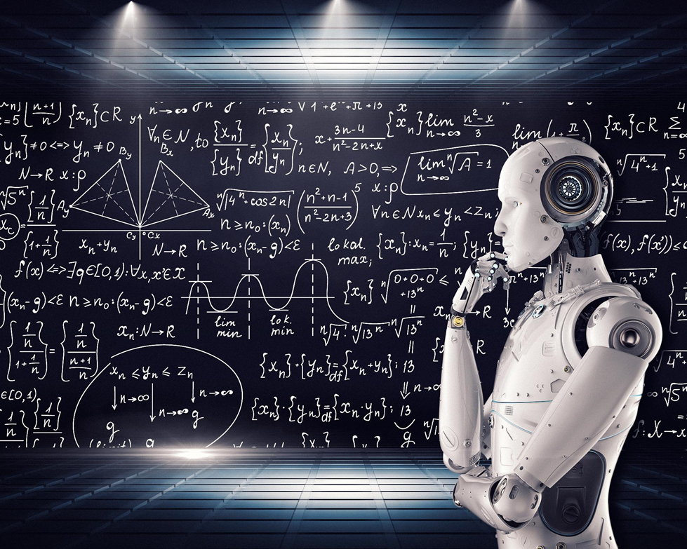
Motivation for explainability
Transparency and enhancing user trust
Asking clarifications before acting to avoid failures

Slide 6
Expected outcome:
Explain the individual instances – For example, why coffee is moved to the kitchen counter from the cabinet ?
Explain the important edges relevant to a prediction – For example, presence of milk on the counter is why coffee was moved to the counter.
Time should be an explanation when needed. – For example, it is 8 AM, and that is why coffee was moved to the counter

Slide 7
Why is this problem different from normal GNNs?
This is neither a link prediction nor a node/graph classification task – rather the output is an edge existence likelihood - adjacency matrix
The graphs are dynamically varying in terms of topology, as objects move
The input data encodes temporal information to model the periodicity of activities across the day.
Here the node features are just one-hot encodings and do not have any meaning

Slide 8
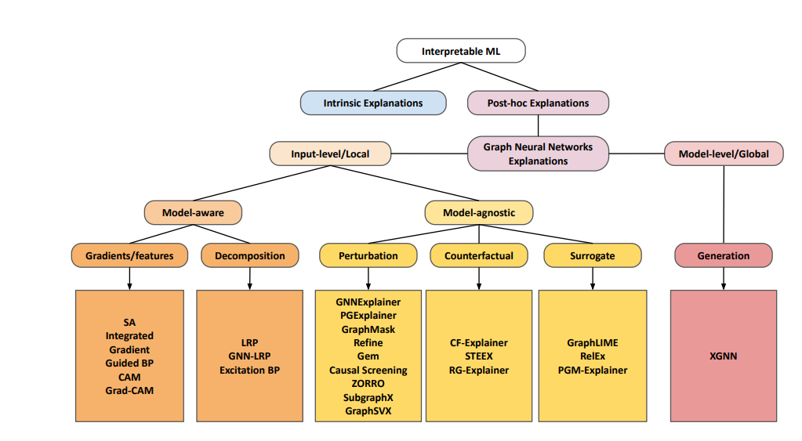
Exploring Baselines

Slide 9

Technical Challenges
Converting the model to be compatible with PyTorch Geometric, to leverage baselines
-> How to convert the model to be a node classification task?
Converting the model output to dual graph and then using the corresponding node predictions
Need to create a new dataloader to be in the PyG format:
-> Needed to consider graph format and preserving the edge, temporal information

Slide 10
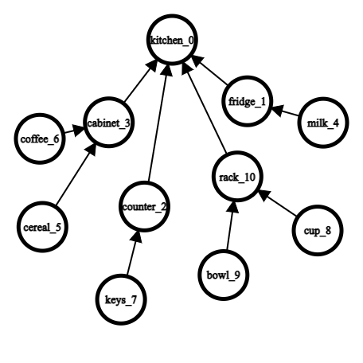
Process
Created a small-controlled temporal dataset and trained the spatio-temporal model on it
Dataset has 3 unique scenarios – such as making coffee, preparing cereal, and a random activity
Ran baselines on this model to check the quality of the explanations

Slide 11
Sample Dataset scenario
START TIME | ACTION – Encoded in x and x_t+1 graphs | Human questions | Sample explanation expected( for cases when base model correctly performs the action)
1 | Base state
6 | Coffee to counter | Why was coffee moved to counter ? | Because it is time t_6
7 | Milk to counter | Why did milk move to counter ? | Because coffee was on the counter
8 | Cup to counter | Why did cup move to counter ? | Because coffee and milk was on the counter
13 | Coffee to cabinet | Why did coffee move to cabinet again ? | Because it is time t_13 ( coffee is prepared by now)
14 | Milk to fridge | Why did milk move to fridge ? | Because coffee is in the cabinet
15 | Cup to rack | Why did cup move back to the rack ? | Because coffee is in the cabinet and milk is in the fridge.

Slide 12
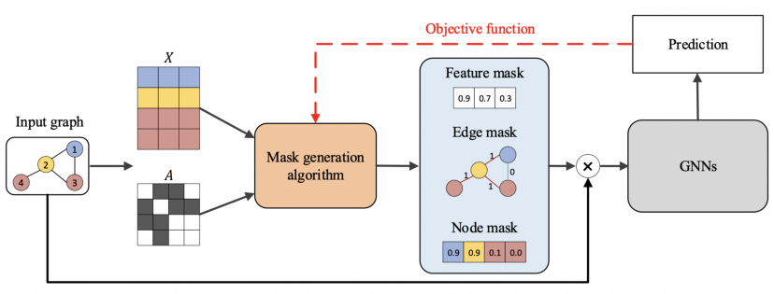
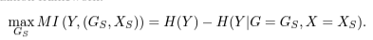
GNNExplainer
Finding a subgraph in the computation graph, that minimizes the difference in the prediction scores using the whole computation graph and the minimal graph

Slide 13
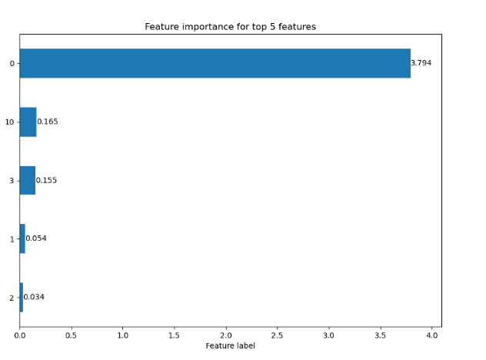
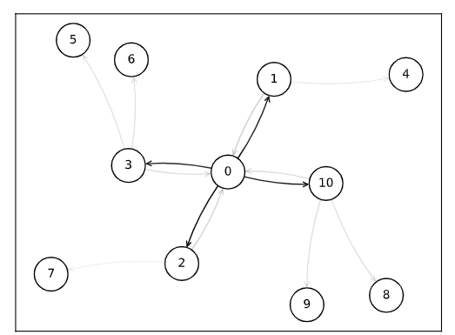
Results from GNNExplainer – explain output of node 2

Slide 14
Comparing Baselines on the model – with manual and qualitative analysis
Baseline | Method | Pros observed | Cons observed
GNNExplainer | Computes the importance of graph entities (node/edge/node feature) by maximizing mutual information | Results were good in certain cases – especially during the middle of an activity when multiple objects were taken out | Widely fluctuating outputs
Saliency ( SA) | Measures node importance as the weight on every node after computing the gradient of the output with respect to node features | Stable outputs, though they were worse than the previous methods. | Gradient methods do not work well with discrete inputs
Integrated Gradients (IG) | Avoids the saturation problem of the gradient-based method Saliency by accumulating gradients over the path from a baseline input (zero-vector) and the input at hand | Same as above | Baseline for graph with no node features is not trivial

Slide 15
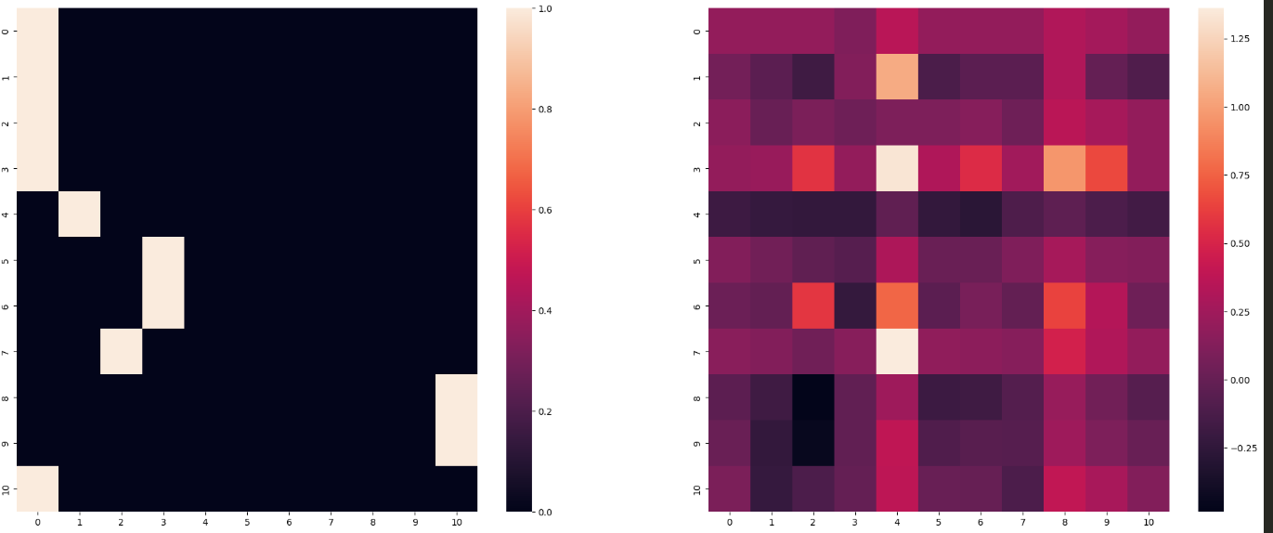
Next Approach – Attention Weights
Leverage attention weights of the model
Compare the four different edges (incoming/outgoing from both the nodes) in one-hop neighborhood
Get top features across the above with normalization
Heat map of input graph and corresponding attention weights

Slide 16
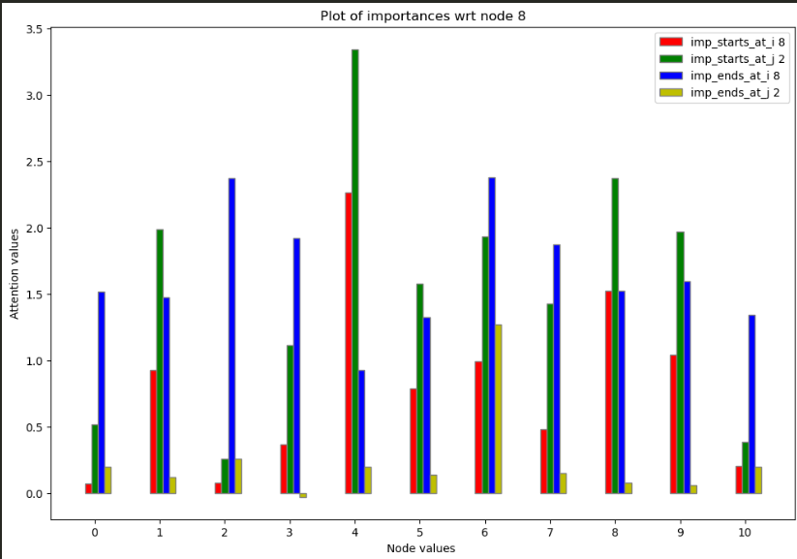
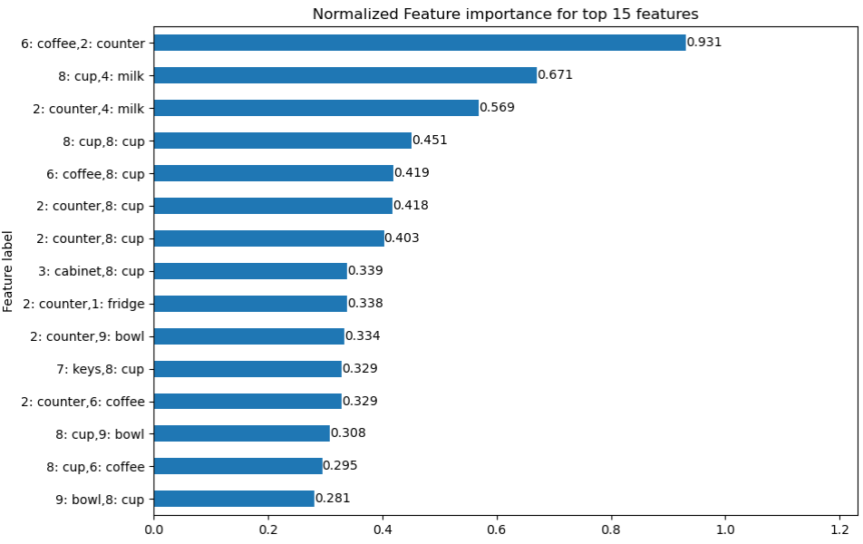
Explain cup(8) moving to counter(2) from rack when coffee , and milk are on the counter

Slide 17
Attention as an explanation
School of thought on using attention for explanations
Attention weights should correlate with feature importance measures (e.g., gradient-based measures);
Alternative (or counterfactual) attention weight configurations ought to yield corresponding changes in prediction (and if they do not, then they are equally plausible as explanations).
Analysis from my experiments:
Implausible edges could become explanations - this is not acceptable
Time could not be explained, as attention corresponds to the adjacency matrix structure
Explanations during removal of objects in an activity are not right

Slide 18
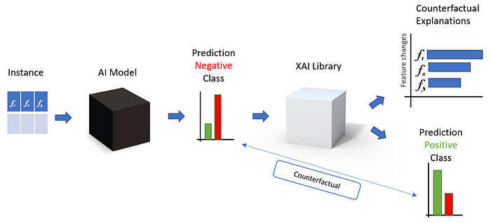
Next Approach – Counterfactuals
Counterfactuals are human-friendly explanations,
contrastive to the current instance and selective

Slide 19
Counterfactuals
Modified Process:
For a node that needs explanation at time t:
Loop through all seen edges in the dataset(prior info) and switch them on, one by one :
If switching to this edge leads to a different prediction for the node in observation, the original edge is a counterfactual
Change the time instance across 6 values: 3 steps in past, 3 steps in future
If this new time instance leads to a different prediction for the node in observation, then time is a counterfactual
Example Explanations:
Presence of coffee on counter is necessary for movement of cup to counter.
Milk moved to counter because it is time ‘x’

Slide 20
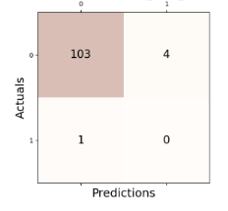
Counterfactuals – Metrics Generation
Created ground truth in the entire dataset for evaluating explanations:
Time is a GT Explanation for the movement of the first transition in the activity
For subsequent transitions in the same activity, edges are a GT
Note: activities occur sequentially and do not overlap
Created new metrics for evaluation:
Soft Recall : Give a high score when even one generated explanation matches with an expected ground truth
Precision: Aims to penalize False positives, i.e. unrelated extra explanations
Edge_Combined F1_Score =2*precision* soft_recall / (precision + soft_recall)
Time_metric: Analogous to Edge soft_recall metric

Slide 21
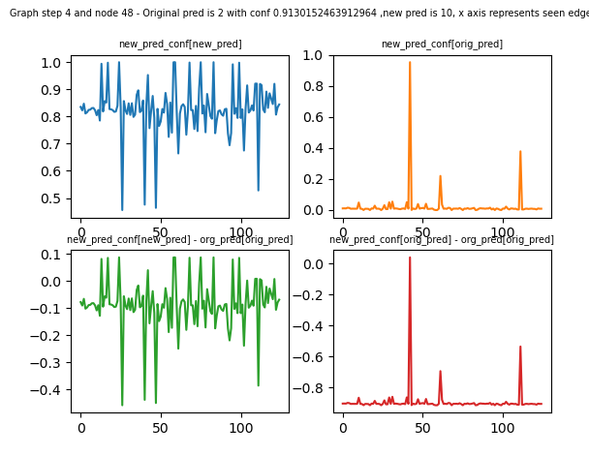
Counterfactuals - threshold
Observation: expecting a different prediction at the node did not give sufficient explanations.
So suggested threshold approach:
Compare ( new confidence score (with the new x matrix) of the old predicted edge - original confidence score of the old predicted edge ) to thresh
This analysis is over the cooking activity in the dataset only - since running counterfactuals is time consuming

Slide 22
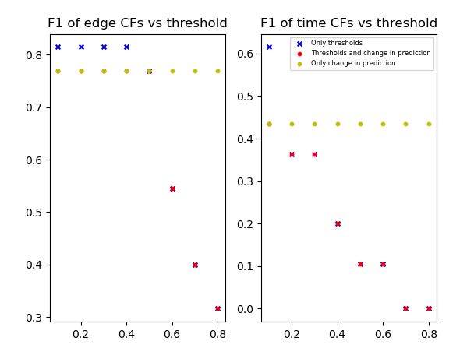
Results of the edge and time metrics
Good results were observed compared to all previous methods, so switched the model to the one trained on original HOMER dataset.

Slide 23
Counterfactuals – Combined metrics
Combined edge and time scores:
For every node in a step of the dataset(10 minutes apart):
If this step is the first movement of an activity sequence
result = Time_metric
Else:
result = Edge_Combined_F1_Score
Used this single metric to evaluate results across activities in the dataset and understand patterns.

Slide 24
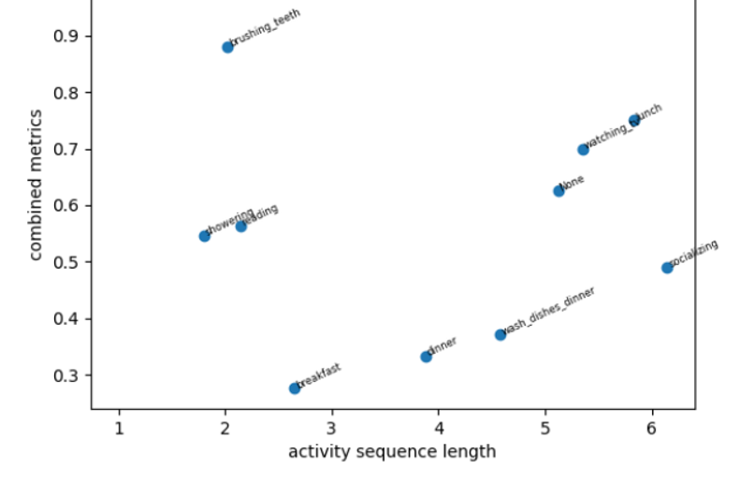
Analysis
Combined Edge-time metric vs Sequence length of activity

Slide 25
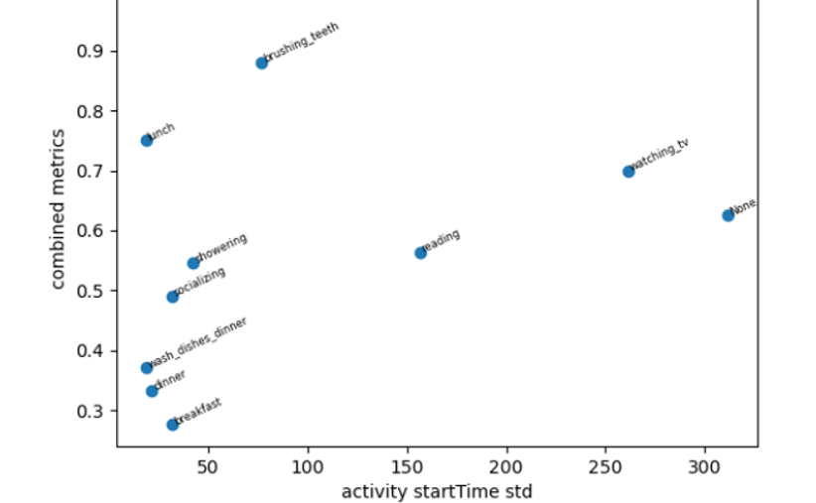
Analysis
Edge-time metric vs Standard deviation of activity start times
Further work in progress

Slide 26

Summary
Knowing the problem statement–
What are we trying to explain ? Local instances or Model-level, Model-agnostic or Model-specific
What are the attributions ? Data’s relational structure (e.g. graph-like), input features
Who is the target audience ? ML model developer or end-user or domain expert or all
What does the ideal explanation look like? Textual or visual
How are the explanations evaluated ?
Quantitative – New metrics, Accuracy ( needs the ground truth) , Fidelity , Sparsity
(or) Qualitative – E.g. Rating with Amazon Mechanical Turk Users.
Title Goes Here
Explore baseline explainers on the model trained with simple data
E.g. Baselines - SHAP, LIME, Counterfactuals, Anchors – Applicable on GCNs, LSTMs as well
Evaluate the explanations qualitatively with the stakeholders - to ensure everyone agrees as explanations are subjective in certain cases
Work with domain experts to utilize prior information – for ground truth, biases in the data.
To build models with more explainability, leverage attention-based approaches.
SW Practices – Maintain W&B logging and git code commits for each experiment
Research Practices – Be aware of the latest papers, tools using social media, github repos,
PyTorch forums

Slide 27
Thank You ! QnA

